Slide 1

SGX security checker A.K.A. “SGX Toctoul”
March 23, 2023
Presenter:
Alex Berenzon

Slide 2
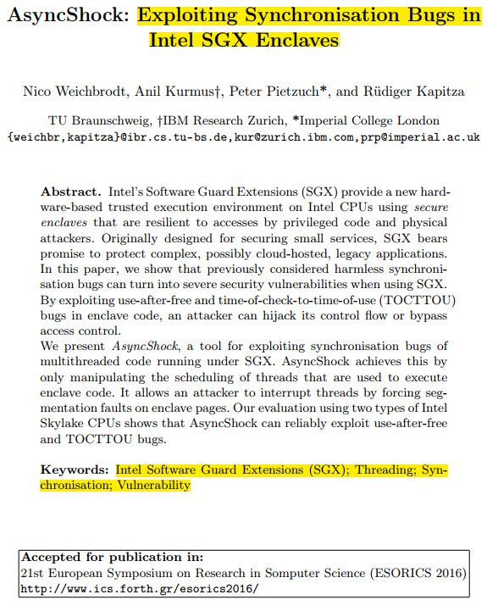
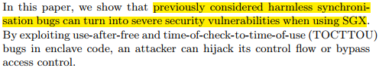
https://www.ibr.cs.tu-bs.de/users/weichbr/papers/esorics2016.pdf
Notes:
Before we start, I’d like to show a research paper that was published just after SGX was released in 2015.
This research shows that timing issues become much critical in enclaves.
I will show how we can reduce this risk

Slide 3

About me
Alex Berenzon
Principal Engineer in SW/FW security
Intel/IPAS/ Security Software and Services

Slide 4
Agenda
TOCTOU and threading race condition vulnerabilities
The importance of timing bugs in privileged/isolated SW
Tool overview
Short demo

Slide 5
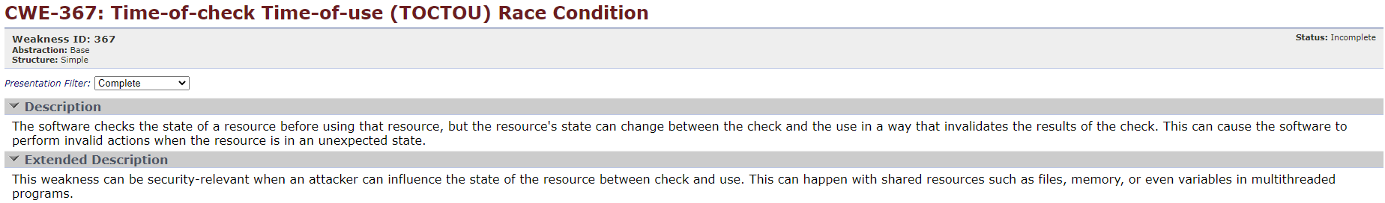



TOCTOU – Time of Check – Time of Use
SW entity
Read to Check
Change
Read to Use
Untrusted
Trusted
Notes:
What is TOCTOU – known CWE
Check - We check that the resource is consistent with restrictions (e.g., boundaries), with itself, etc.
Using without checking can cause unexpected state (e.g., buffer overflow, out of bounds access, WWW - write, what, where)
Let’s see a simple demonstration
SW entity reads the resource and checks it for consistency
SW entity reads the resource again and uses it. It was already checked, right?
If the attacker still has the access to the resource, he can change the resource after the check, and SW entity will use a non-checked resource
https://cwe.mitre.org/data/definitions/367.html

Slide 6
TOCTOU – Time of Check – Time of Use
Copy
SW entity
Change
Check
Use
Untrusted
Trusted
Notes:
The solution is simple
Copy the resource to a protected domain, so the attacker will not be able to modify it after the check
Demonstrate via the animation. Mention that:
if changed before copy – the check will catch it
If modified after the copy – we don’t care since we are using the copied instance
https://cwe.mitre.org/data/definitions/367.html

Slide 7

TOCTOU – Security Engine example
// Enclave EDL
trusted {
public uint32_t ProcessInstruction([user_check] void* instructionData);
1
2
3
4
5
6
7
8
9
10
11
12
13
14
15
16
17
18
19
20
21
22
23
// Security Engine instruction data structure
struct SEInstructionHeader {
unsigned int numOfArgs;
unsigned int* argsList;
unsigned int result;
};
// Security Engine instruction processing function uint32_t ProcessInstruction(void* instructionData) {
// local buffer for instruction arguments
unsigned int argsLocalBuffer[MAX_NUM_OF_ARGUMENTS];
struct SEInstructionHeader* instruction = (struct SEInstructionHeader*)instructionData;
if (!instruction || !sgx_is_outside_enclave(instruction, sizeof(struct SEInstructionHeader)))
return 0;
if (instruction->numOfArgs > MAX_NUM_OF_ARGUMENTS)
return 0;
// copy arguments to local buffer to prevent TOCTOU
memcpy(argsLocalBuffer, instruction->argsList, instruction->numOfArgs * sizeof(unsigned int));
...
Read for check
Change numOfArgs
Read for use
Notes:
Can you spot the TOCTOU?
First, we read for check
After, we read for use
Meanwhile the attacker can change
There is one more bug besides TOCTOU. Can you spot it?

Slide 8
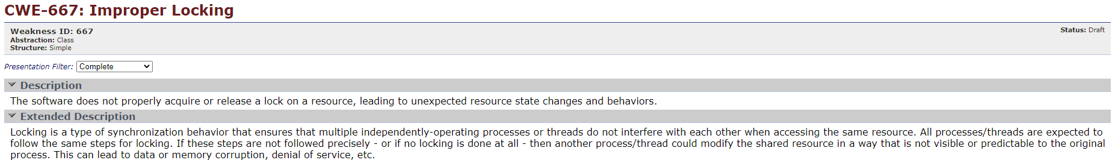
Threading race condition - Improper Locking
TBD
Notes:
Race condition happens due to improper locking which is a known CWE
Resource is being modified unexpectedly by another thread due to missing or incorrect synchronization

Slide 9
Threading race condition - Improper Locking
Both threads work on same data
edit
Thread A
read
write
Shared data
read
write
Thread B
edit
Value from Thread B is overwritten by Thread A

Slide 10
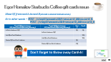
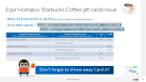
Threading race condition – desired behavior
Atomic operation
edit
Thread A
read
write
Shared data
read
write
Thread B
edit
Atomic operation
Thread B gets the correct value
Notes:
SGX enclave can not trust any OS sync primitives, must rely on SGX primitives

Slide 11
Timing bugs in privileged/isolated SW
TOCTOU – relevant for untrusted → trusted data interaction
SGX - An enclave reading from untrusted memory
Race conditions can be exploited for memory corruption and even arbitrary code execution
SGX - OS kernel controls thread scheduling, making it easier to exploit
Secret data dependent execution flow
SGX - Side channel disclosure of secrets handled by the enclave
Existing checking tools are not suitable for SGX enclaves
Notes:
We put the logic in enclaves due to security risk, while not having tools to validate

Slide 12
Facts to notice
Dynamically compromising the enclave doesn't change its measurement
Not reflected in remote attestation to provision secrets
Not reflected in access to Sealing keys
For regular SW there are tools (e.g., Valgrind tools)
No tools for TOCTOU, race detection, side channel leaks for SGX enclaves
No tools for SGX specific issues, like AEPIC leak

Slide 13


Detecting timing bugs
Manual inspection
Costly process
Experts' shortage
Hard to find
Not consistent
Automation
Tool to understand the environment (sync primitives, trust boundaries)
No expert needed
Less chance for human error
Much faster
Notes:
What can we do?
Manual inspection of race conditions and TocTou issues
Costly process
Lack of experts
Automate
Tool to understand the environment (sync primitives, trust boundaries)
Inputs to cover (unit testing, fuzzing)
No expert is needed
Less chance for human error
Much faster
the hands of the OS kernel
Limitations of existing tools for special env
What can we do?
Manual inspection of race conditions and TocTou issues
Costly process
Lack of experts
Automate
Tool to understand the environment (sync primitives, trust boundaries)
Inputs to cover (unit testing, fuzzing)
No expert is needed
Less chance for human error
Much faster
the hands of the OS kernel
Limitations of existing tools for special env

Slide 14

Motivation – Crypto API toolkit
We found ourselves in this situation in one of our SGX based projects and how we handled it
SoftHSMv2 SW library enclavization
PKCS#11 API
Security Objectives – Never expose the secret keys protected by the enclave
TOCTOU vulnerability found by a security researcher as part of the bounty program
Bug are social creatures
Notes:
PKCS11 API are complex (e.g., attributes hierarchy) requiring "user-check" pointer parameters
Since bugs are “social creatures” - we decided to look for similar issues and not only fix the found one
Crypto API Toolkit for Intel(R) SGX (CTK) aims at enhancing the security of data and key protection applications by exposing interfaces that run the key generation and cryptographic operations securely inside an Intel(R) Software Guard Extensions (SGX) enclave. The operations are exposed and supported via PKCS11 interface for Linux.
https://github.com/intel/crypto-api-toolkit

Slide 15
Results on Crypto API toolkit
Manually discovered 17 TOCTOU issues (~15000 LOC)
Effort - 2 security experts for full week
Running the tool discovered 5 additional TOCTOU issues​
Deeply nested - very hard to find manually​
2 hours effort
No security expertise is needed
Compensated for our human limitations
Notes:
Difficult – several levels of indirection

Slide 16
SGX Security Checker – dynamic multi-checker tool
Detecting TOCTOU
Analyze every memory access to detect more than one access to same external memory within an ecall
Detecting potential races
Analyze every memory access to detect access to same internal memory location by more than one thread without a trusted sync
Detecting AEPIC leak
Analyze every memory access to detect unaligned or partial access to external memory
Detecting usage of pointer without range checking
Analyze every memory access to external memory and verify that it was checked before to be out of enclave
Detecting side-channel leak*
Trace every instruction, logging all instruction pointers and memory addresses that get accessed, and comparing logs across subroutine invocations to ensure a constant execution profile. Use taint analysis to cut down on false positives.
Detecting direct secret leak*
Taint Analysis to discover tainting of untrusted memory
* WIP

Slide 17

Demo

Slide 18
Limitations
Requires to build and run the enclave in SGX SDK simulation mode
Notes:
Difficult – several levels of indirection

Slide 19
Next steps
Integrate secrets leakage checkers
Run an evaluation pilot
Assess value
Get feedback
We are looking for pilot partners.
Please contact me
alex.berenzon@intel.com
Thank you!

Slide 21
Writing an enclave – theory and reality
Gene Spafford (cyber security advisor to the White House and over a dozen government agencies and major corporations)
“The only truly secure system is one that is powered off, cast in a block of concrete and sealed in a lead-lined room with armed guards - and even then, I have my doubts.”
Follow the security principle – “Reduce the attack surface!”
General logic
Intel® SGX trust boundary
Most critical
logic

Slide 22


Writing an enclave – theory and reality
On the other hand - 1st rule of programming -
"If it works - don't touch it"
Entire SW app is put in an enclave
Intel® SGX trust boundary
General and critical logic
Notes:
Show that the attack surface is much bigger
Mention some examples:
Graphene framework - AI

Slide 23


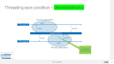
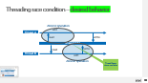
Egor Homakov Starbucks Coffee gift cards issue
Move 5$ from card A to card B (all credit is stored on Starbucks servers)
Or in other words –
POST /step1?amount=5&from=card_A&to=card_B
POST /step1?amount=5&from=card_A&to=card_B
Thread @ Starbucks server POST /step1?amount=5&from=card_A&to=card_B | Card A | Card B
Is Card-A balance < 5$? | 5$ | 5$
Add 5$ to Card-B balance |  | 10$
Deduct 5$ from Card-A balance | 0$
Thread 1 @ Starbucks server POST /step1?amount=5&from=card_A&to=card_B | Thread 2 @ Starbucks server POST /step1?amount=5&from=card_A&to=card_B | Card A | Card B
Is Card-A balance < 5$? |  | 5$ | 5$
 | Is Card-A balance < 5$?
Add 5$ to Card-B balance |  |  | 10$
 | Add 5$ to Card-B balance |  | 15$
Deduct 5$ from Card-A balance |  | 0$
 | Deduct 5$ from Card-A balance | -5$
Don’t forget to throw away Card-A!
Notes:
Let’s see a real example
I’m sure you all familiar with Starbucks. They have gift cards with credit. Their web site provided a service to transfer funds from one gift card to another.
Note that Starbucks servers are protected – I’m limited, able only to call it via valid APIs
Let’s see how it works.
Show the flow with 1 thread
Show the flow with 2 threads

Slide 24
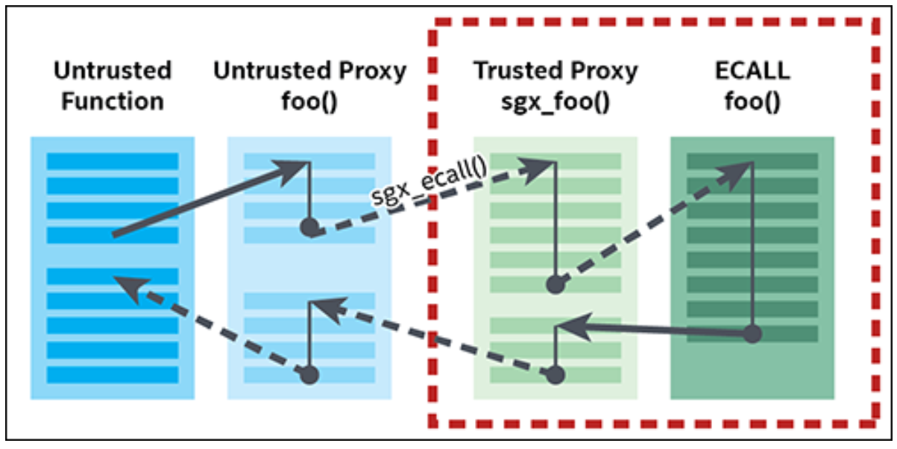
Intel® SGX Enclave's API
Auto generated Proxy Functions - EDL
Marshaling data into and out of the enclave memory
Slow
Size might be unknown
Solution - user_check
[user_check]
"With great power comes great responsibility!"
Notes:
Interface is defined via EDL (Enclave Definition Language (EDL)
Marshaling - operate on these copies of the original memory buffer
Peter Parker principle
Checks:
The buffer is outside the enclave
TOCTOU

Slide 25
Timing bugs and security
Timing bugs can cause attacker’s beneficial memory corruption
Memory corruption can lead to exploitation
Reveal a secret
Change critical data
Arbitrary code execution
Notes:
Examples:
TOCTOU – can change size/index value after check
Race condition – creates invalid state

Slide 26
Intel® Software Guard Extensions - Intel® SGX
Attack surface
today
App
App
App
OS
VMM
Hardware

Slide 27
Intel® Software Guard Extensions - Intel® SGX
X
Enclaves
Confidentiality and Integrity-protected data & executing code
HW controlled access to secrets
Smaller attack surface
Familiar development/debug
Standard OS environment and programming model
Single application environment
Enclave
App
App
App
X
X
OS
VMM
Hardware
Notes:
Security principle – reduce the attack surface

Slide 28


Intel® SGX Programming model
Application
Untrusted Part of App
Trusted Part
of App
App is built with trusted and untrusted parts
App runs & creates enclave which is placed in HW-protected memory
Trusted function is called
Code running inside enclave sees data in clear
External access to data is denied by HW
Function returns; enclave data remains in trusted memory
Call Gate
Create Enclave
Execute
Return
CallTrusted Func.
SSN: 999-84-2611
m8U3bcV#zP49Q
(etc.)
Other SW
Notes:
2. Untrusted part creates the enclave

Slide 29

Analysis - Potential TOCTOU detection by the tool
ECALL scope
Maintain a list of accesses per externally accessed memory location
False positives
Untrusted code provides same pointer to more than one parameter
Reading OCALL result from several OCALLs within an ECALL
Notes:
Candidate for removal

Slide 30

Analysis - Potential race detection by the tool
Monitors internal memory accesses and sync events
Ignores stack memory locations
Considers only trusted sync primitives
Significantly slows down execution
Notes:
Candidate for removal
Replacing human time with machine time!

Slide 31
Egor Homakov Starbucks Coffee gift cards issue
Move 5$ from card A to card B
Or in other words –
POST /step1?amount=5&from=card_A&to=card_B
Is Card-A < 5$?
Add 5$ to Card-B
Deduct 5$ from Card-A
Thread @ Starbucks server
Read Card-A
Read Card-B
Write Card-B
Write Card-A
Card balance A – 0$
Card Balance B – 10$
Card balance A – 5$
Card Balance B – 10$
Card balance A – 5$
Card Balance B – 5$

Slide 32
Egor Homakov Starbucks Coffee gift cards issue
Move 5$ from card A to card B
Or in other words –
POST /step1?amount=5&from=card_A&to=card_B
POST /step1?amount=5&from=card_A&to=card_B
Is Card-A < 5$?
Add 5$ to Card-B
Deduct 5$ from Card-A
Thread @ Starbucks server
Read Card-A
Read Card-B
Write Card-B
Write Card-A
Card balance A – -5$
Card Balance B – 15$
Card balance A – 0$
Card Balance B – 15$
Card balance A – 5$
Card Balance B – 10$
Card balance A – 0$
Card Balance B – 10$
Card balance A – 5$
Card Balance B – 5$
Read Card-A
Read Card-B
Write Card-B
Write Card-A
Thread-2 @ Starbucks server
Is Card-A < 5$?
Add 5$ to Card-B
Deduct 5$ from Card-A
Don’t forget to throw away Card-A!
Reading 10$

Slide 33
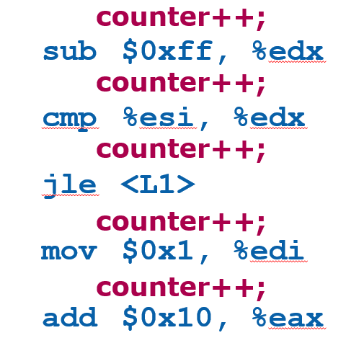
Instrumentation
A technique that inserts extra code into a program to collect runtime information
Source-Code Instrumentation
Static Binary Instrumentation
Dynamic Binary Instrumentation
Pin is a dynamic binary instrumentation engine
Notes:
Instrument code just before it runs (Just In Time – JIT)
No need to recompile or re-link
Discover code at runtime
Handle dynamically-generated code

Slide 34
PIN
Not an acronym
Rich set of APIs
Multiplatform support
Various PinTools
memory leaks
uninitialized data
dangling pointer
deadlocks
data races
concurrency
locking
Pin can be used to instrument all the user level code in an application
Notes:
Pin Is Not an acronym
Provides rich set of APIs to write, in C,C++,assembly, your own instrumentation tools, called PinTools
Multiplatform supports x86, x86-64,Linux, Windows, MacOS
Instruments multithreaded applications
Supports signals
Detects: memory leaks, uninitialized data, dangling pointer, deadlocks, data races
Performance analysis: concurrency, locking

Slide 35
Tool requirements
Identify TOCTOU issues
Read-Read TOCTOU – same address being read from within an ecall
Write-Read TOCTOU – same address being read from after being written to within an ecall
Identify threading race conditions
Identify same memory access between threads with incorrect sync
Application
(untrusted)
Enclave
1. ecall (enter enclave)
2. read/write memory X
3. read memory X
4. ecall (exit enclave)
Notes:
Candidate for removal
PKCS11 API are complex (e.g., attributes hierarchy) requiring "user-check" pointer parameters

Slide 36

Tool mechanism details
Use SGX simulation mode → binary instrumentation
Maintain call stack per thread → provide user readable context for detected issues
Stop analysis in OCALLS/SGX internal flows → prevent false positives
Hook events in the enclave
Memory accesses
Function enter and ret
Threading events - SGX spin locks, SGX mutexes and flags
OCALLs and simulated flows

